Slide 1
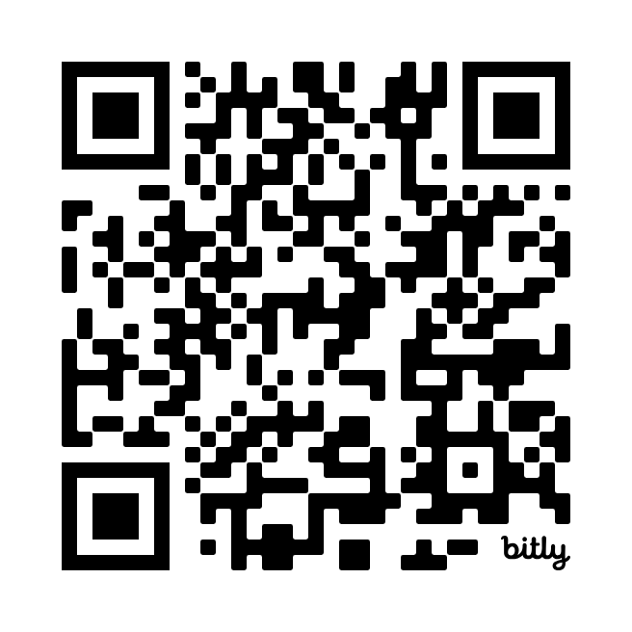
Santa Barbara Newcomers
Introduction & Orientation
Download Here:
https://bit.ly/sbncmembership
Eric Cox
Steve Denton
Co-VP’s of Membership
Spring 2025

Slide 2

Topics we will cover tonight …
What is SBNC
Week in the life of SBNC
How can you get the most from your membership
Tools and Training
One on us …

Slide 3
Santa Barbara Newcomers Club – Mission Statement
The purpose of the Club shall be to promote friendship and to aid in the social, cultural and philanthropic orientation of persons new to the Santa Barbara area.

Slide 4
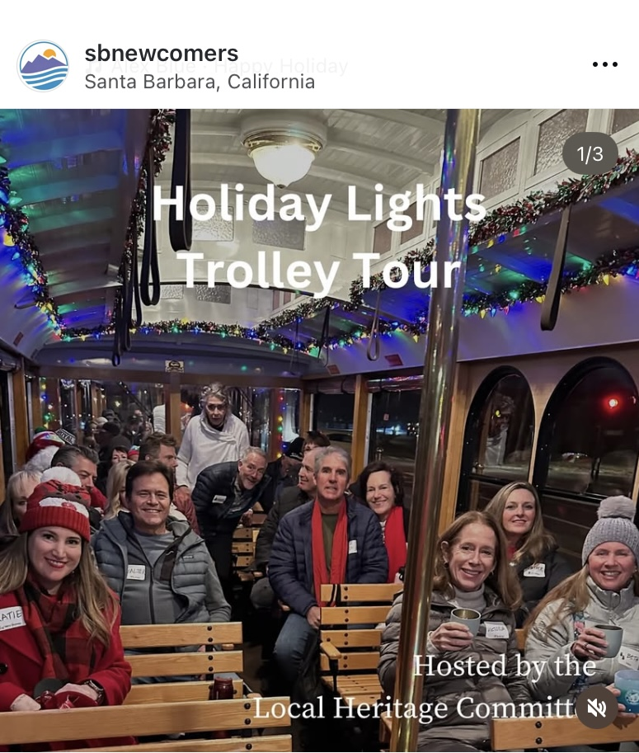
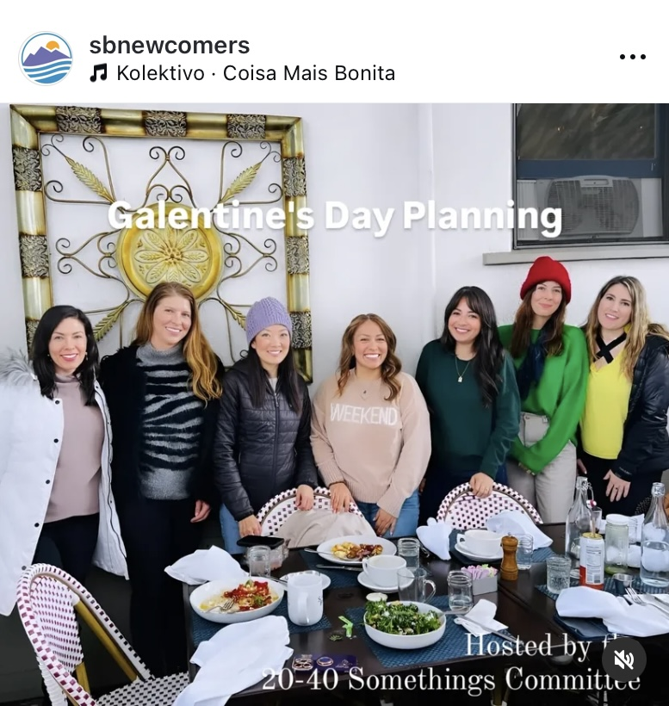
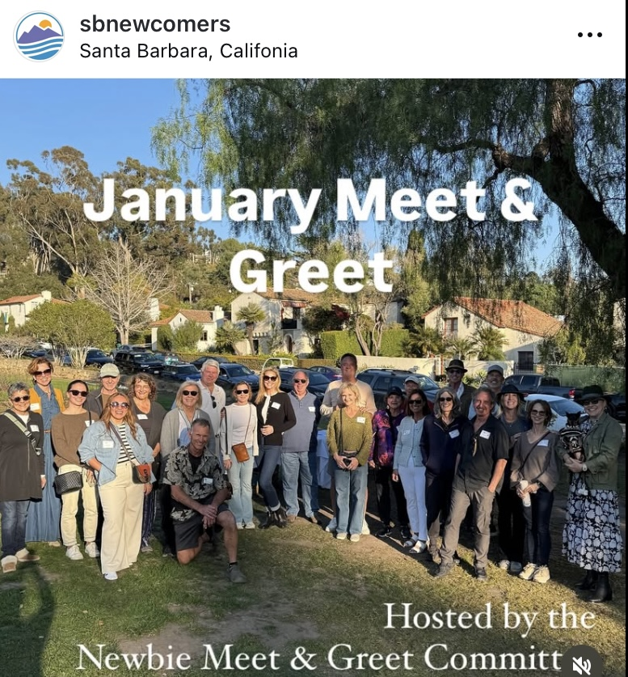
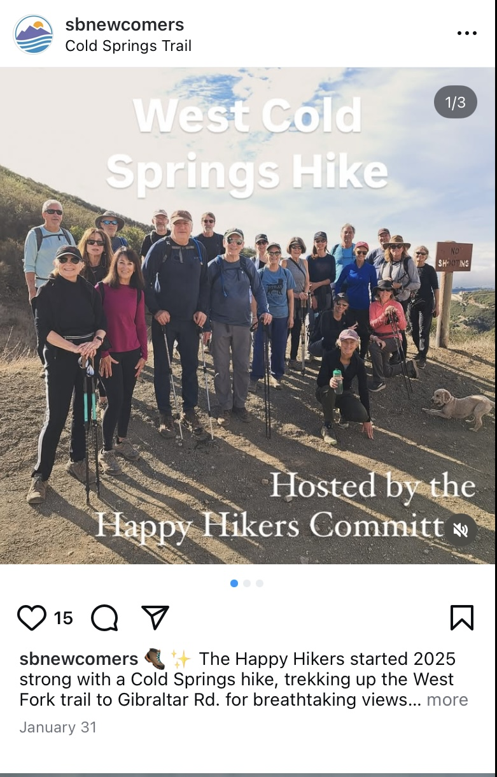
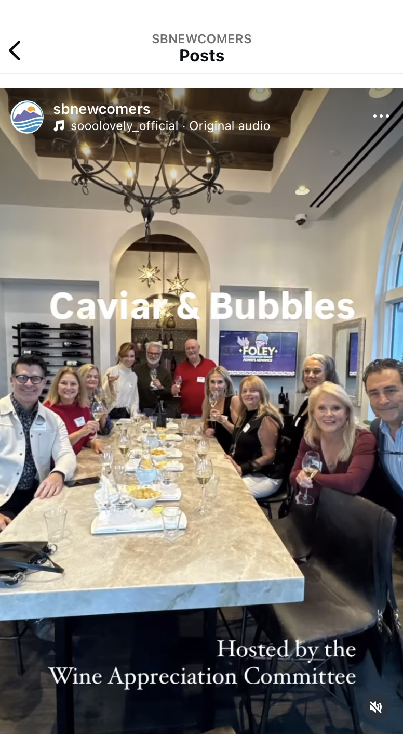
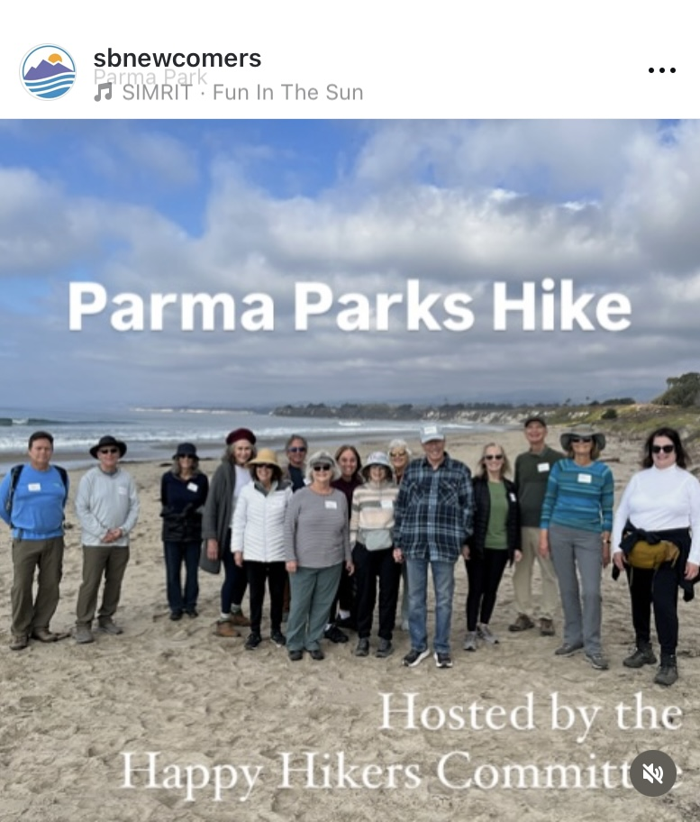
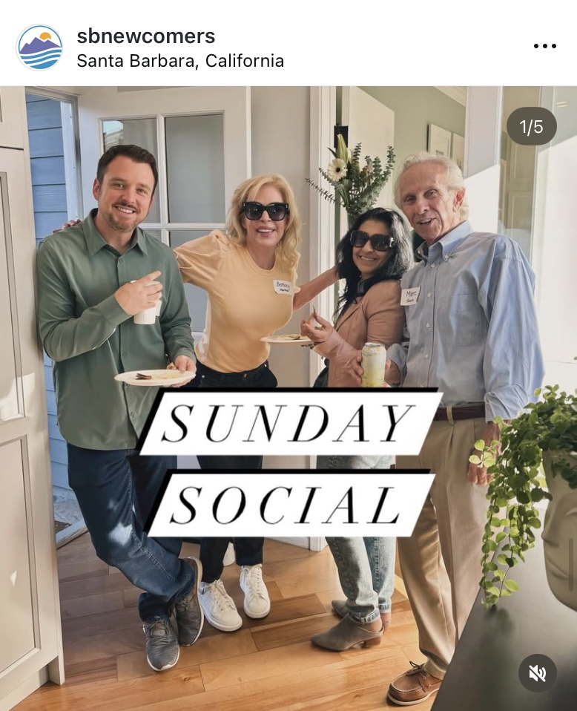
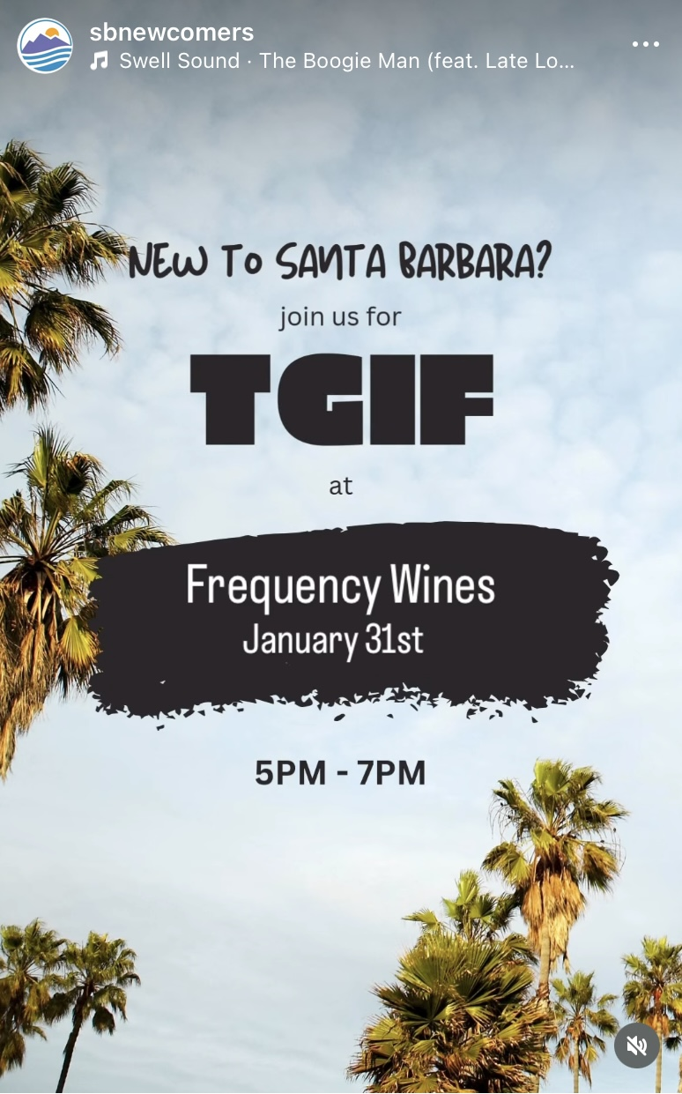

Some of our recent events!

Slide 5
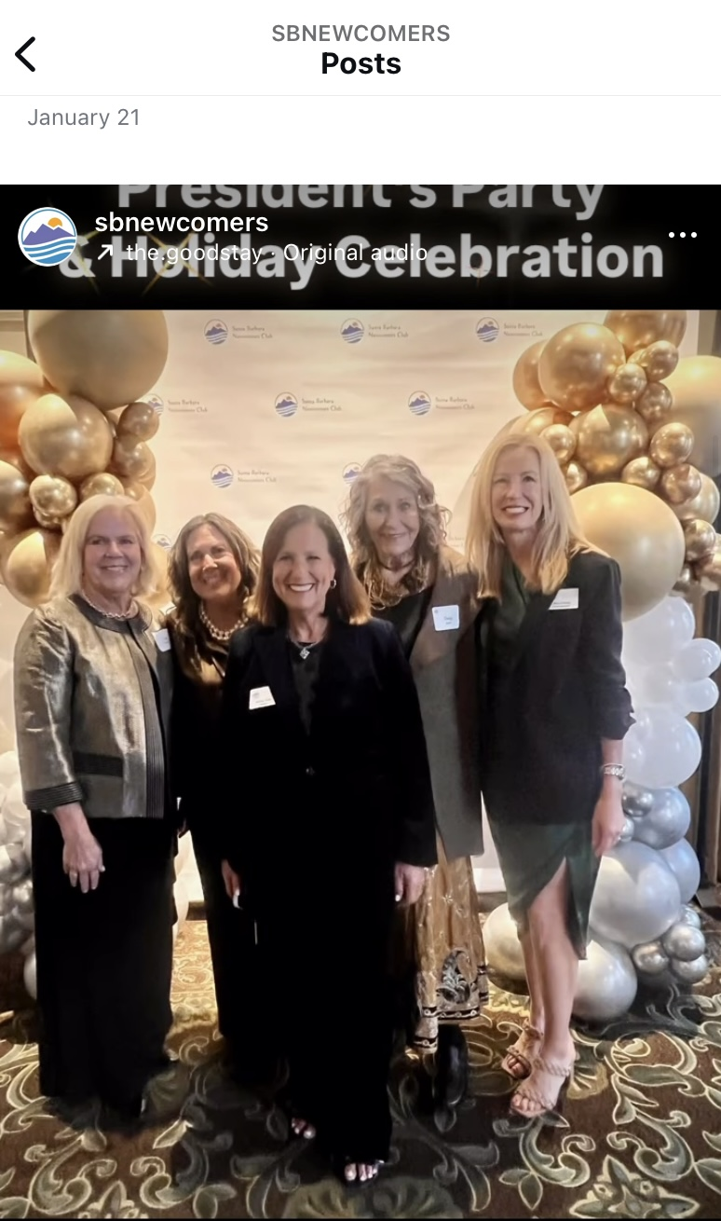
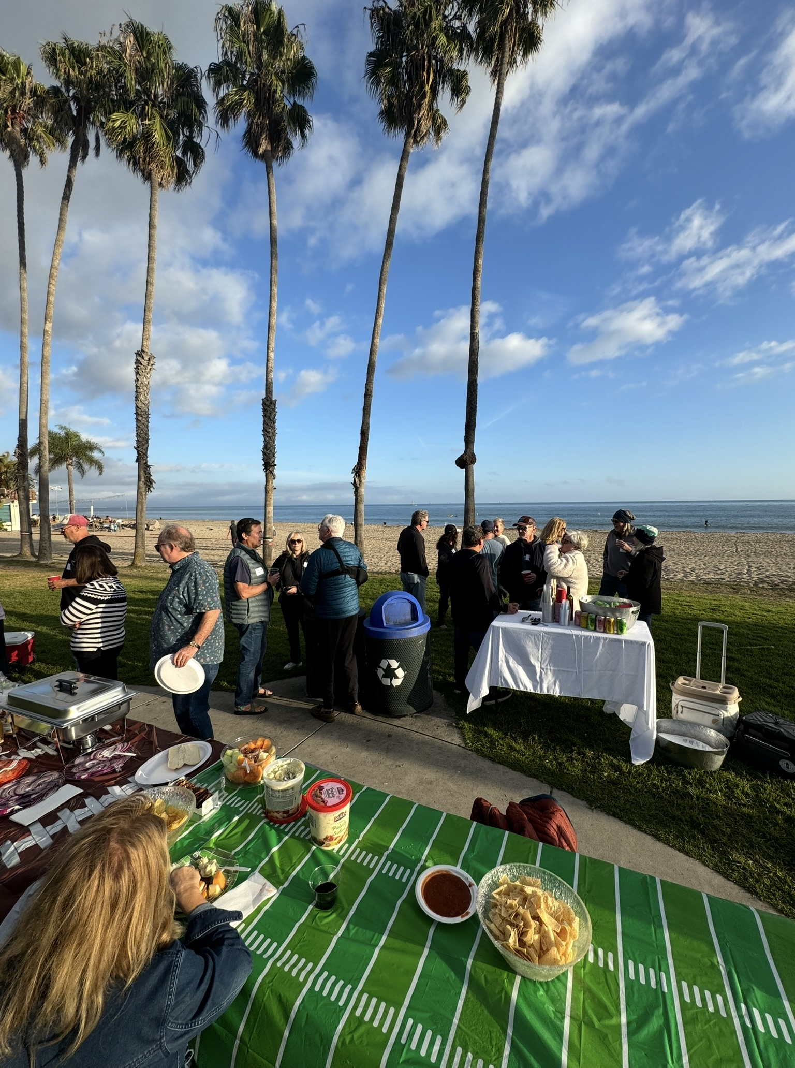
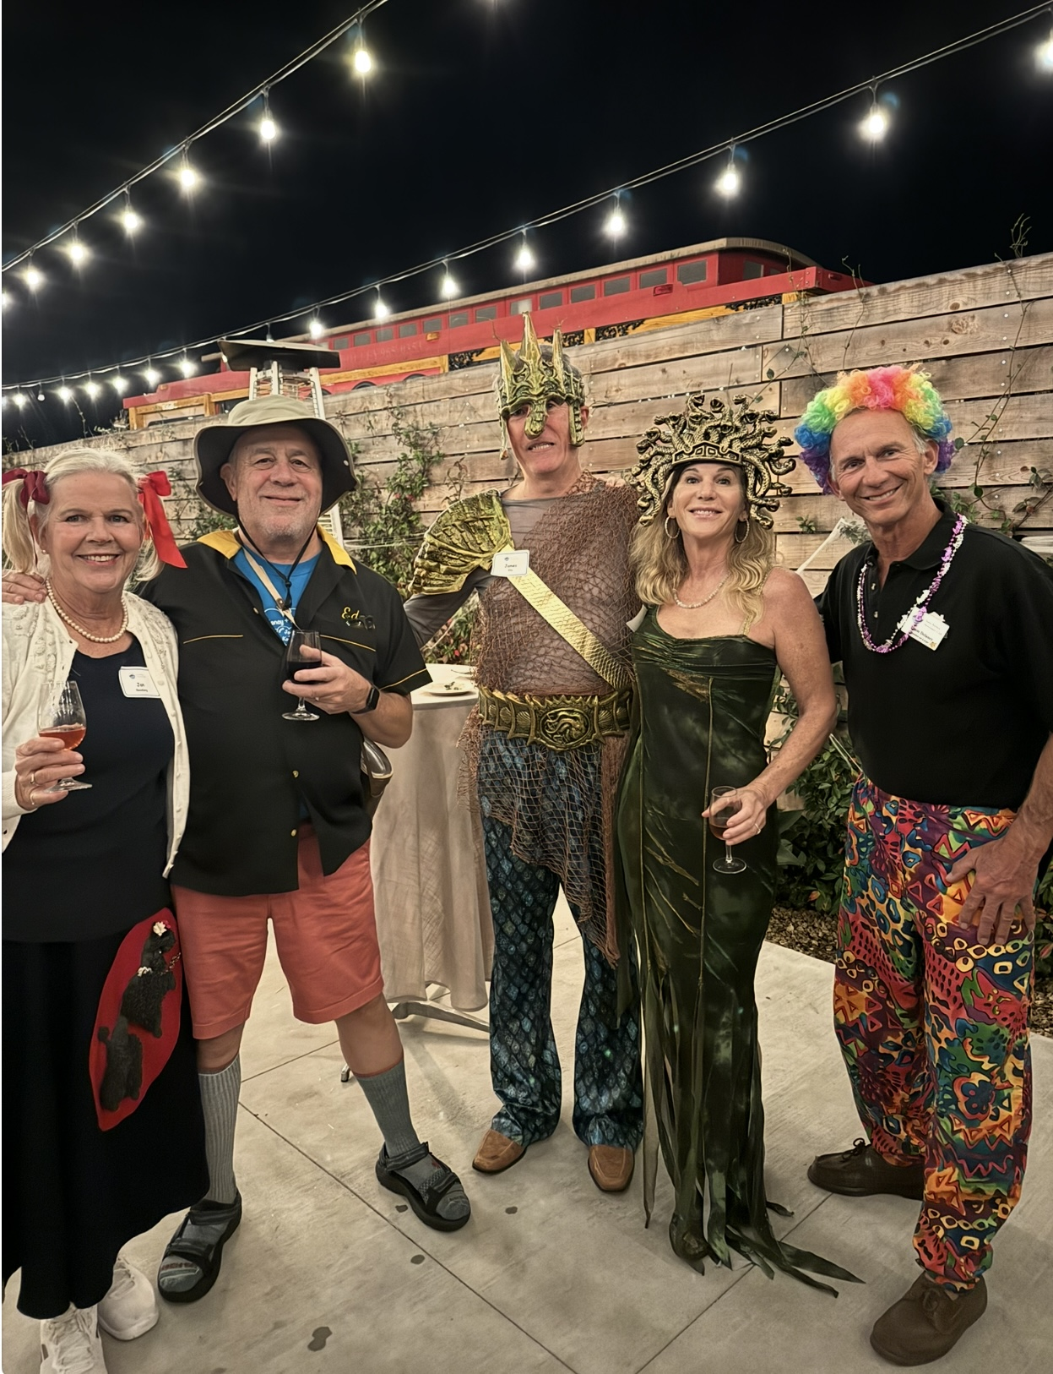
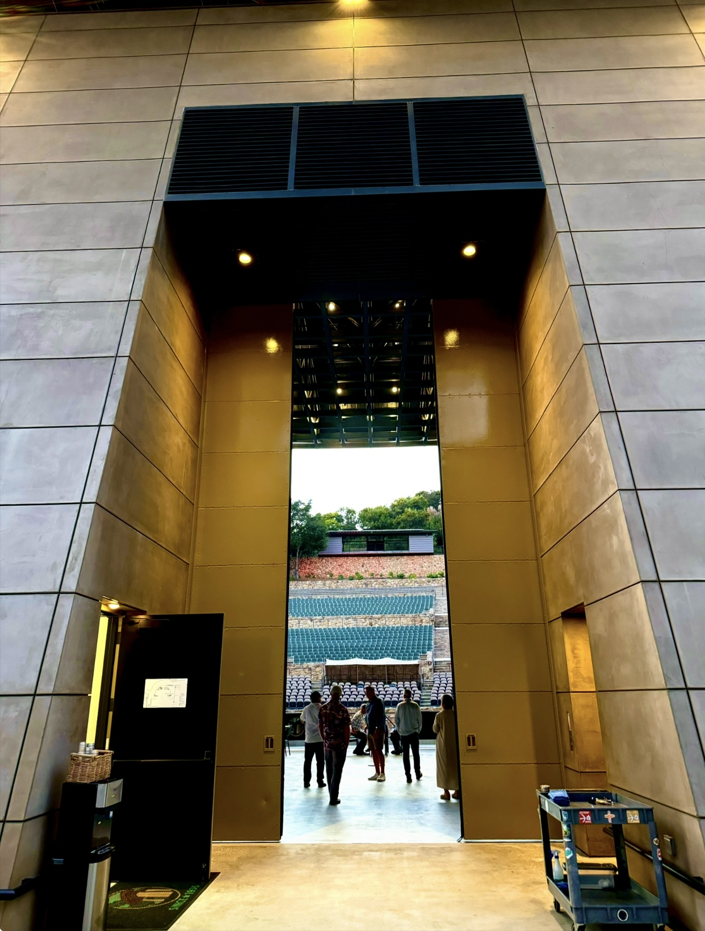
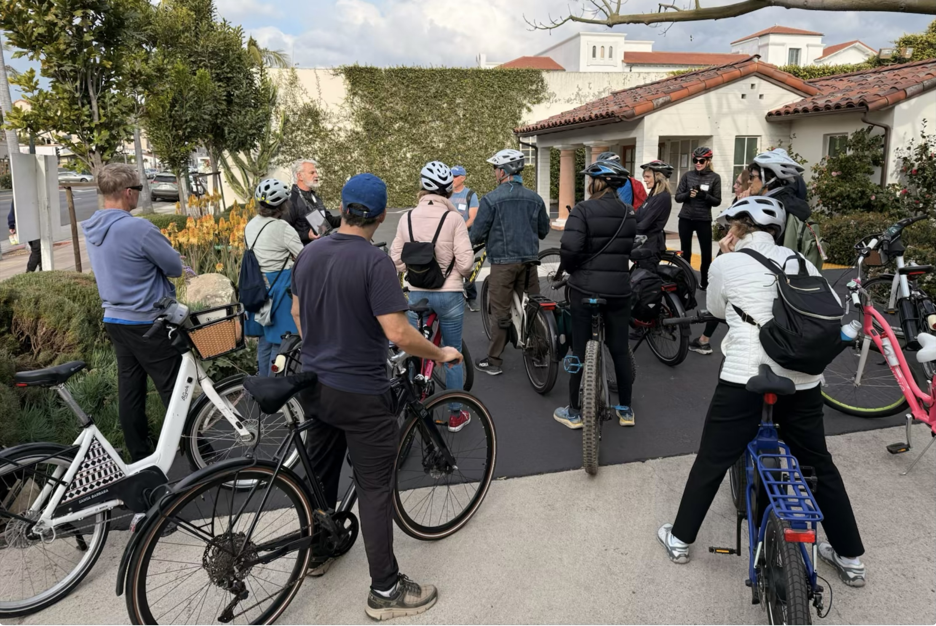
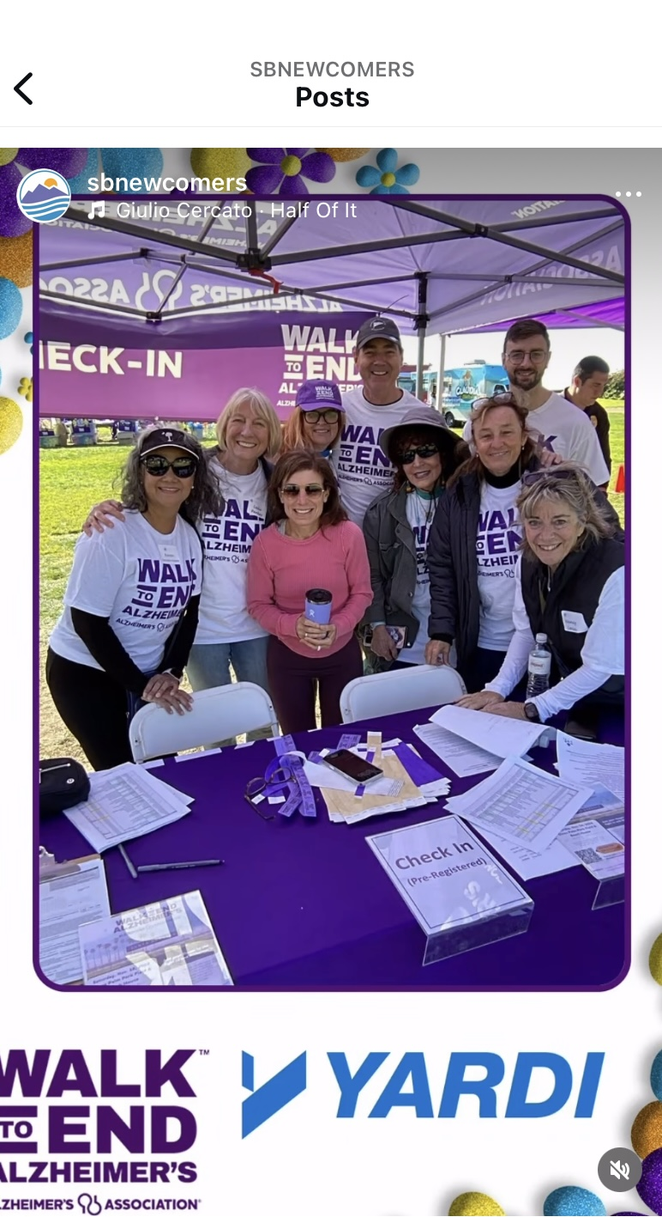
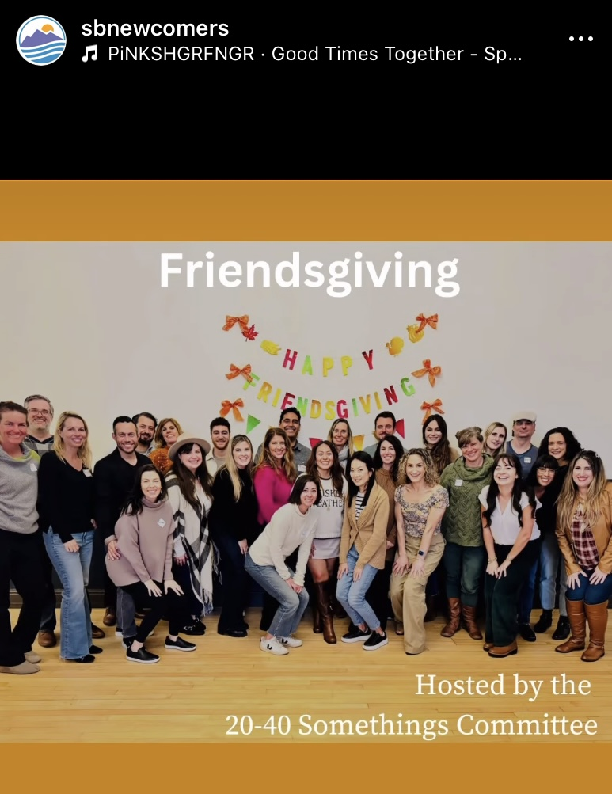
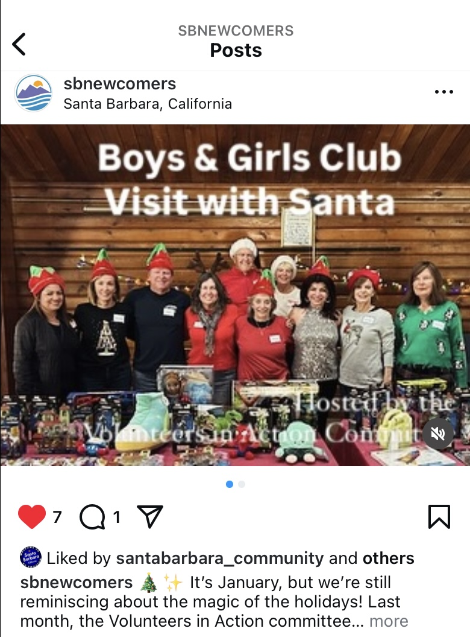
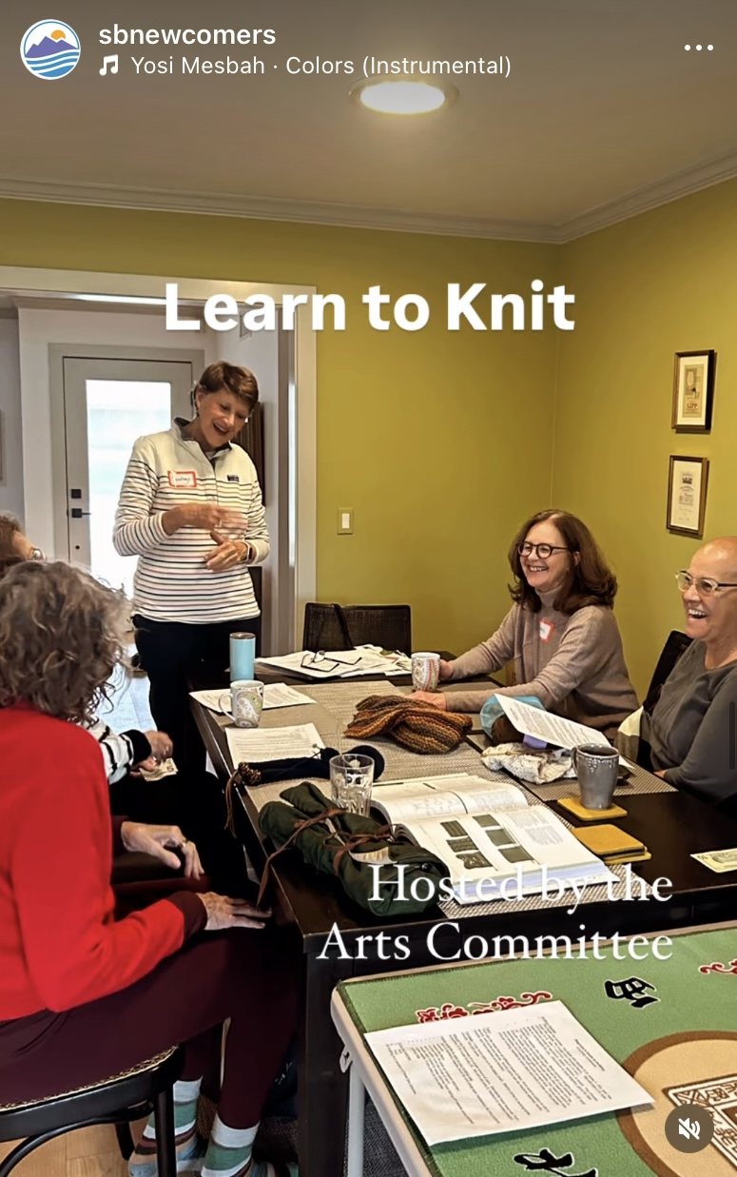
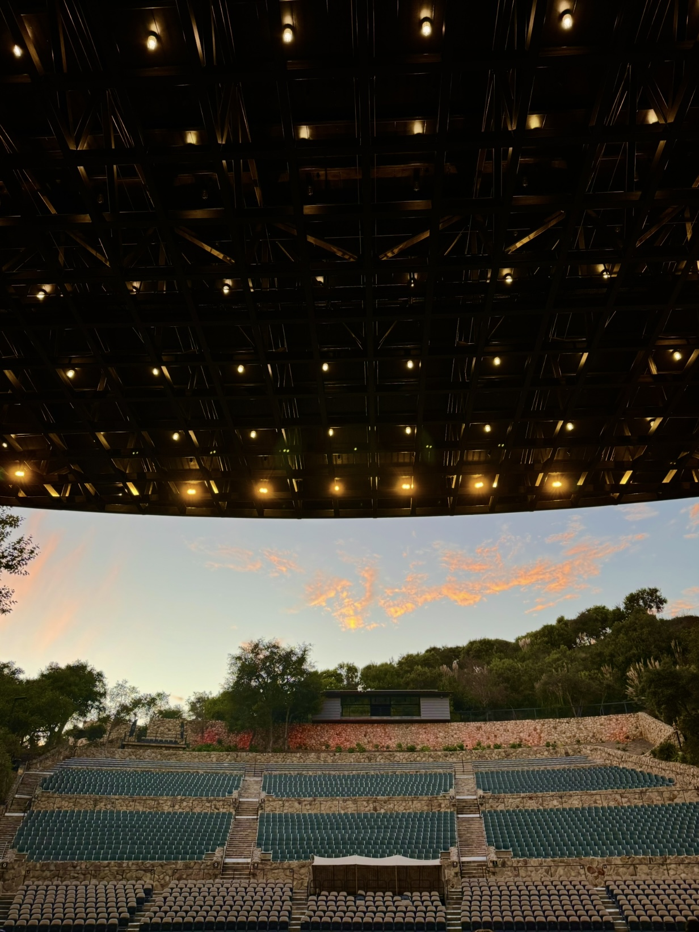
Some of our recent events!

Slide 6
A Bit of History
Established in 1956
One of the largest Newcomers Club in US
~675 members
2 Years of membership
3rd Year option if you have taken on a leadership/org role
Typically, 50+ events each month
59% sold out last month
Truly something for everyone!!

Slide 7
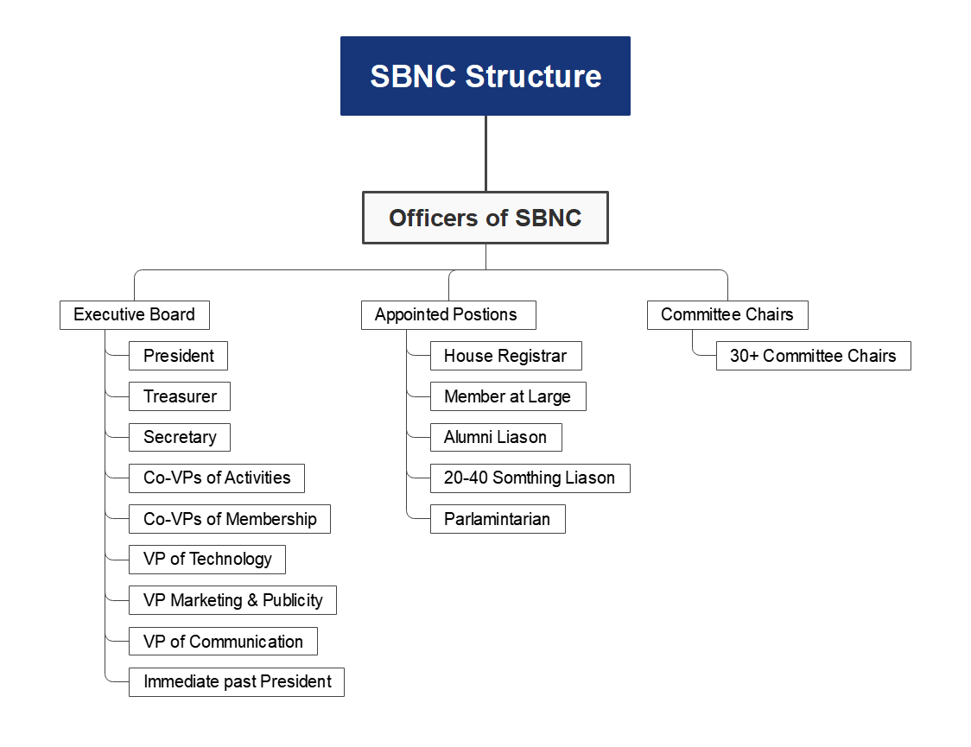
Organization Structure
As outlined in SBNC Bylaws:

Slide 8
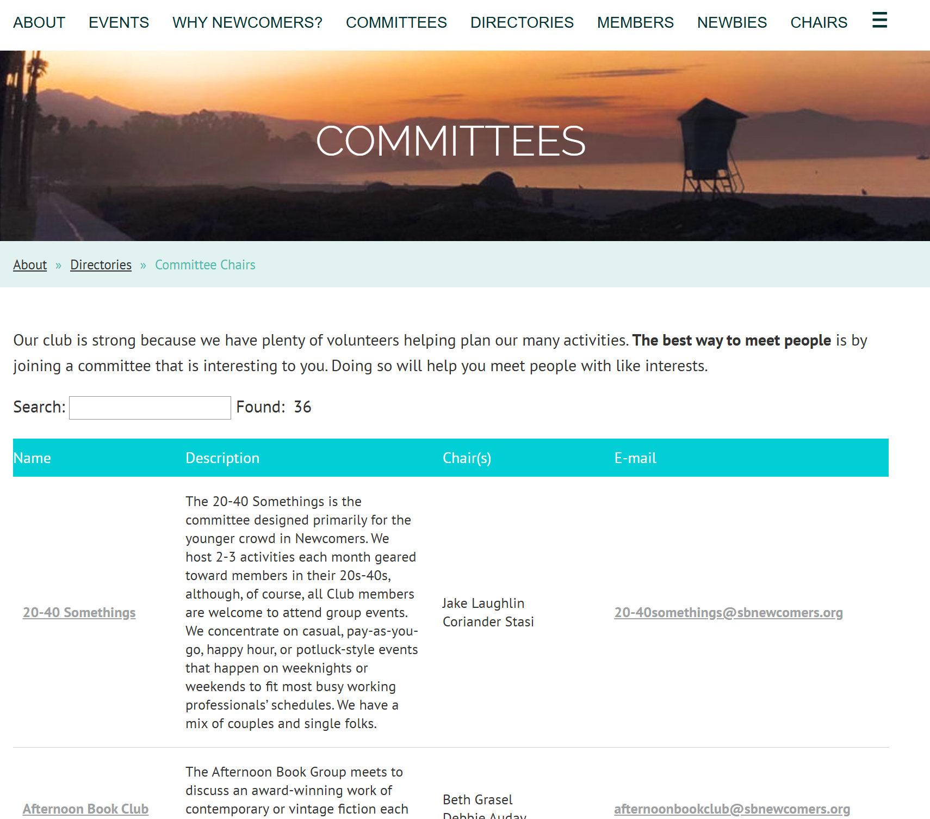
Committees – Spring 2025
Learn More & Contact:
20-40 Something
Current Events
Cycling
Dance Party
Dining In
Epicurious
Evening Books & Bites
Golf
Hablemos Espanol
Happy Hikers
Mas Musica
Sunday Social
Pop Up
Snow Sports
Wine Appreciation
Theater Lovers
Travel Lovers
Afternoon Book Club
Arts
Beer Lovers
Games
Girls Night Out
Knitting
Local Heritage
Mindfulness
Out to Lunch
Stride by the Tide
TGIF
Volunteers in Action
Weekend Amblers
Newbie Meet & Greet

Slide 9
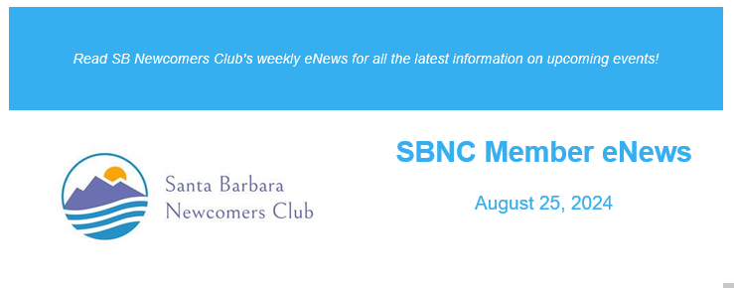
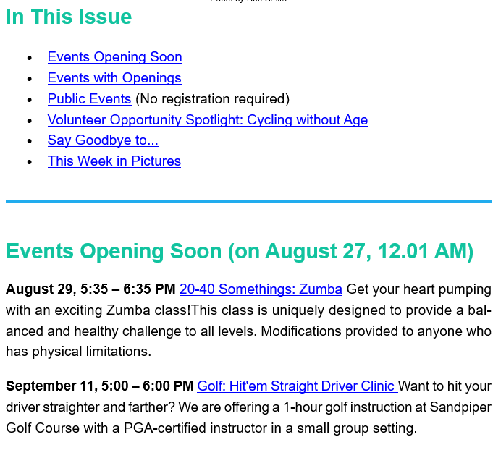
Let's talk tools
Use the tools to learn what is going on:
Wild Apricot App (“wild apricot for members”)
Weekly “e-News” blast (comes out every Sunday)
Instagram (@sbnewcomers)
SBNC Website (https://www.sbnewcomers.org/
Tips …
Sign-up for events early (Tuesday AM/midnight live)
Use your “Newbie” Status
First 90 days
Top of Waitlist
Some events reserved spots
Use the waitlist (often people cancel)
Be aware if you cancel you only get a refund if your spot is filled off waitlist
* Add membership@sbnewcomers.org to your whitelist or check spam folders

Slide 10
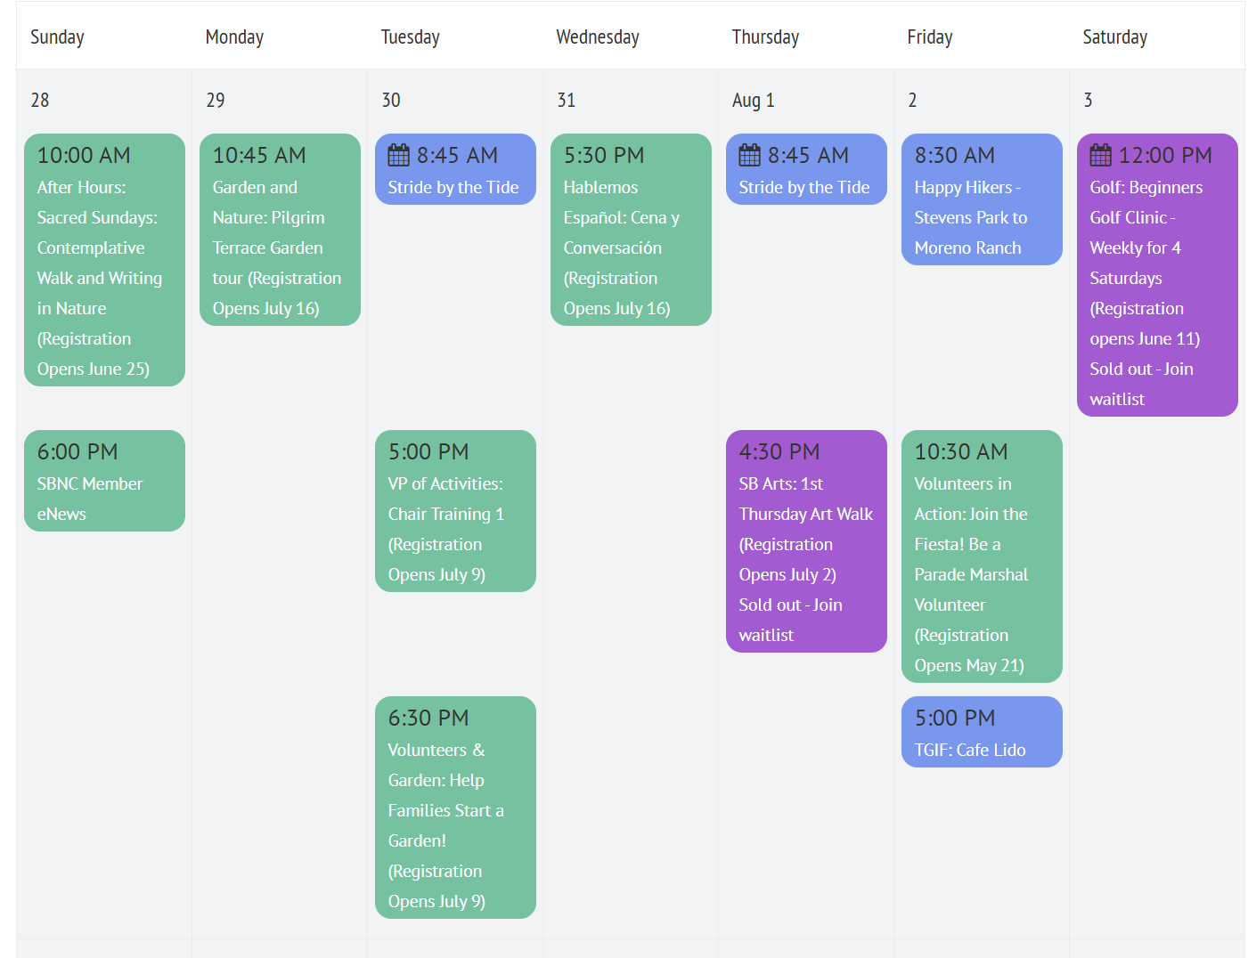
Week in the Life …
Sunday Night eNews Review
Look for new events
Get ready for Tuesday
Tuesday (midnight) – sign ups live
Use your App for constant updates & to connect with other SBNC members
Example Calendar from Website

Slide 11
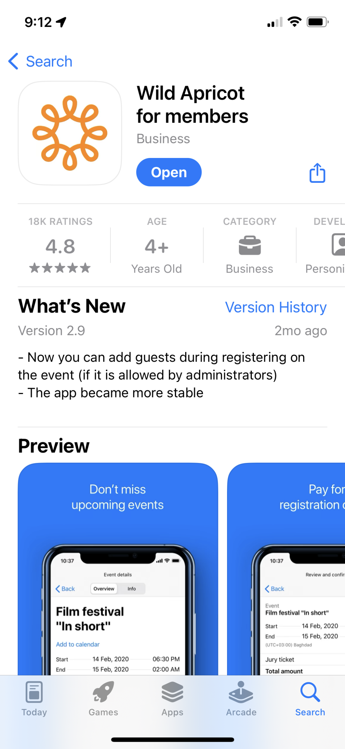
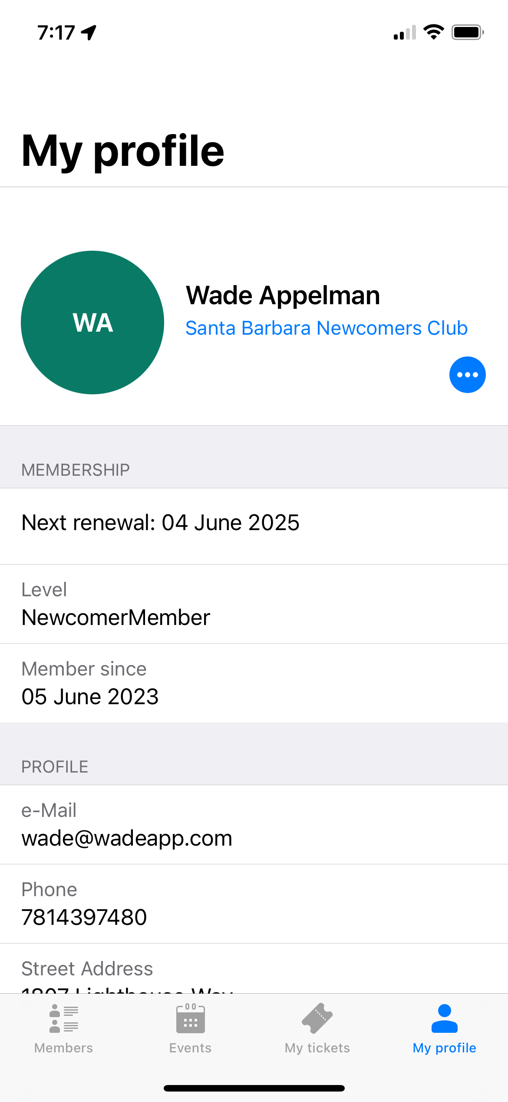
Wild Apricot (Phone App)
Download from App Store
“Wild Apricot for members”
Login with your SBNC login
Same one you signed up with to join

Slide 12
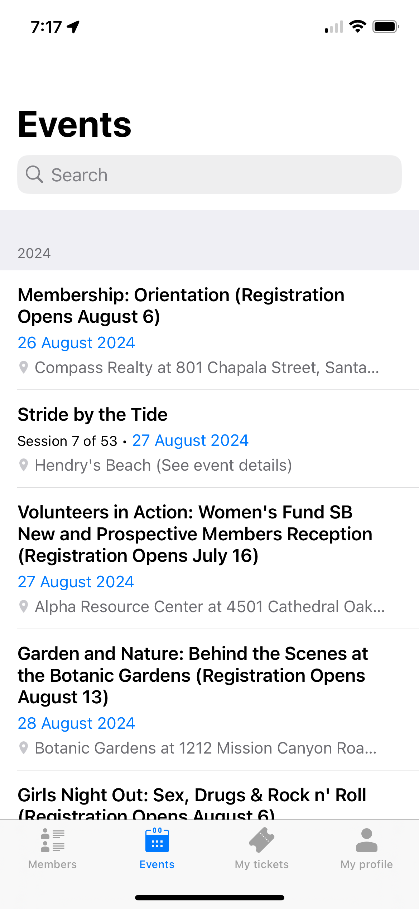
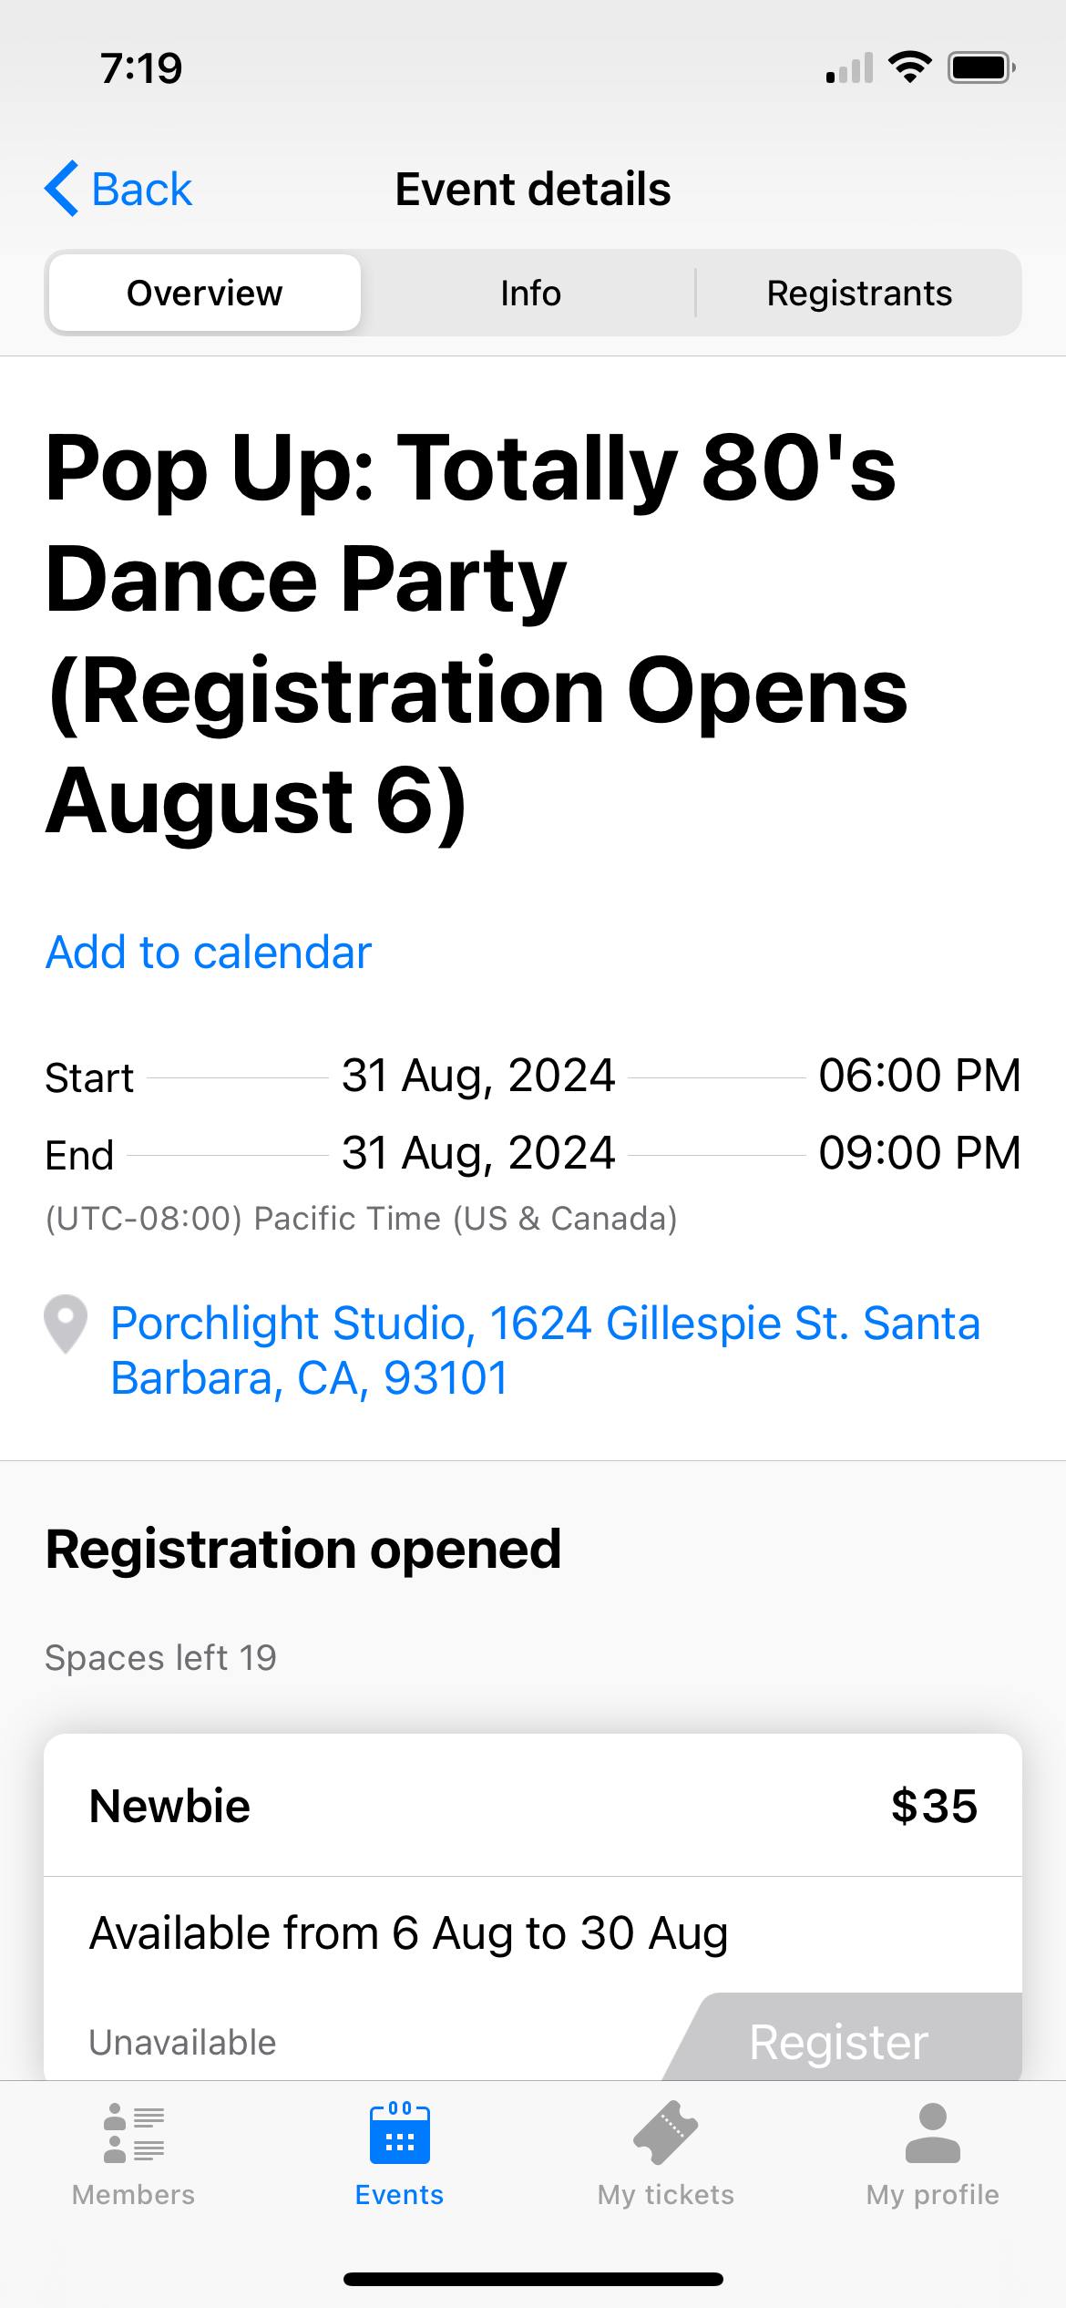
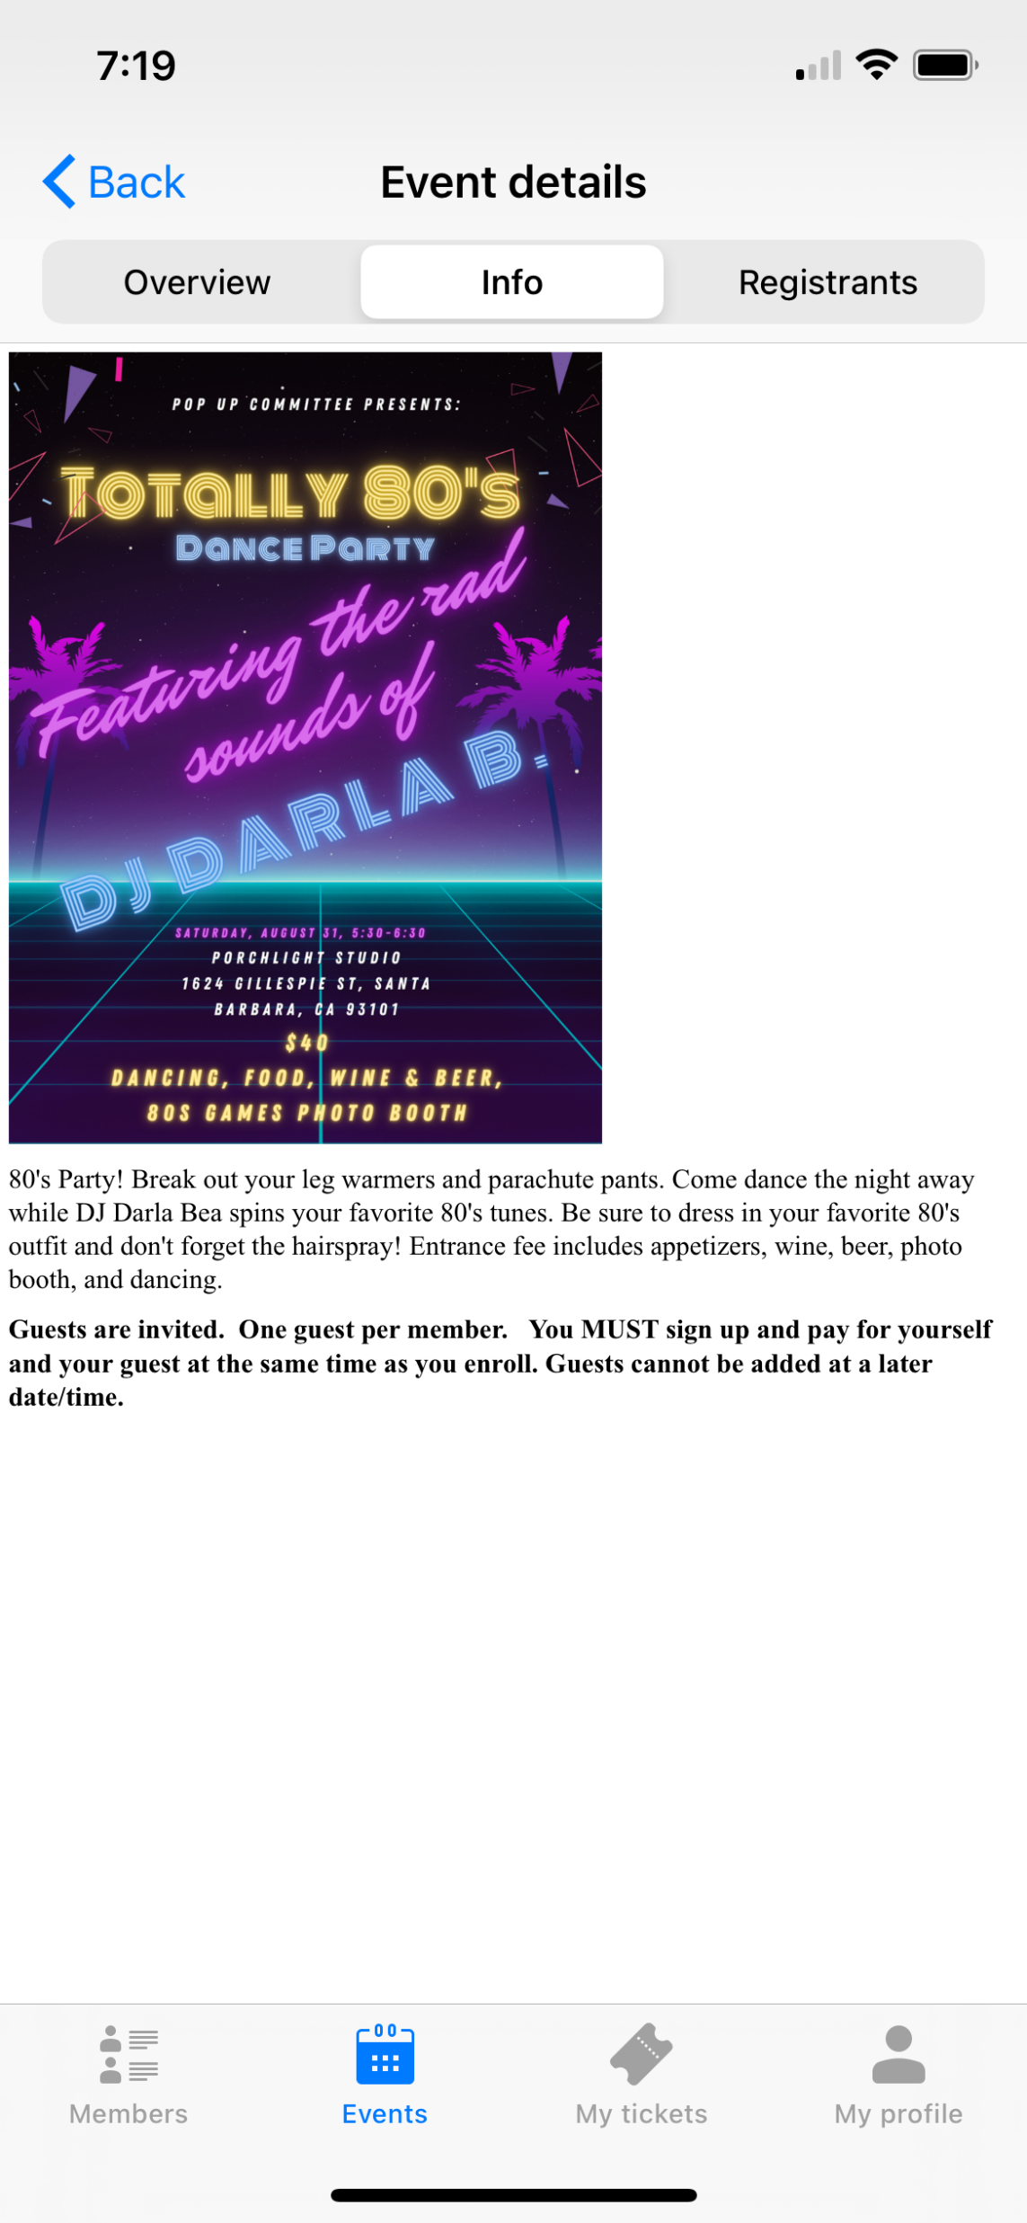
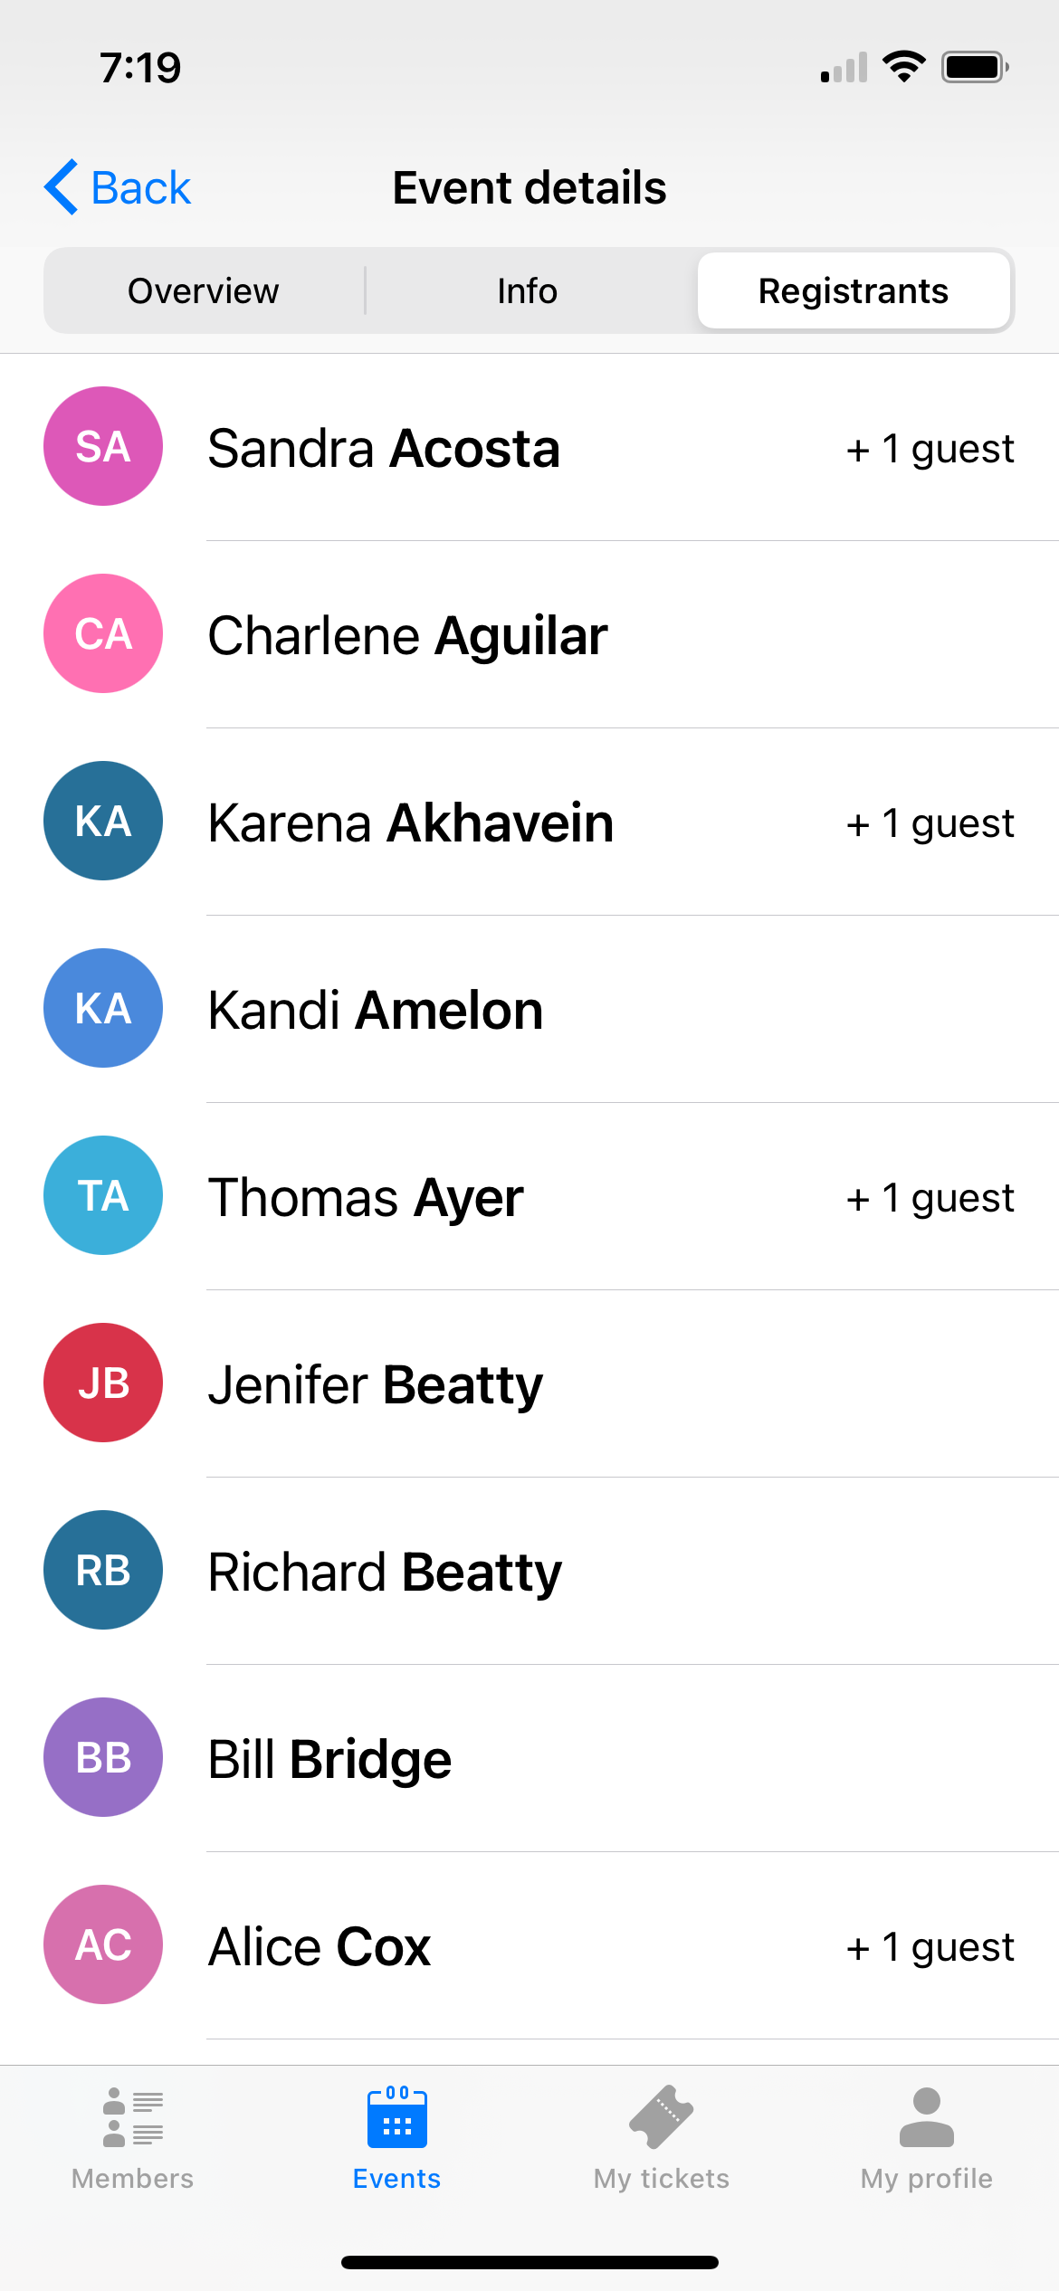
Key App Features
Events:
What you can do:
See calendar
Event Sign-Up
Track your tickets
Find members

Slide 13
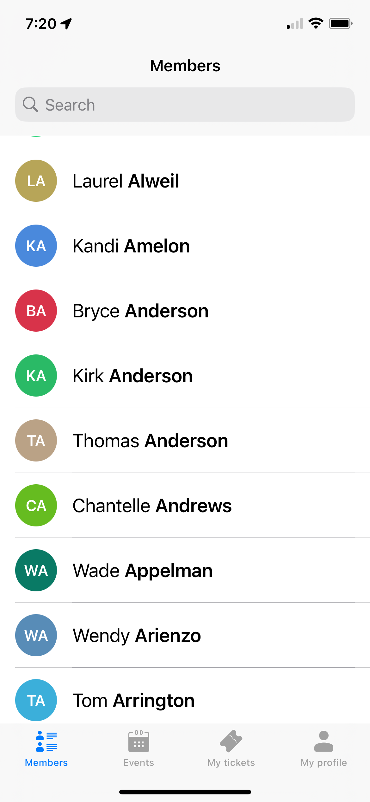
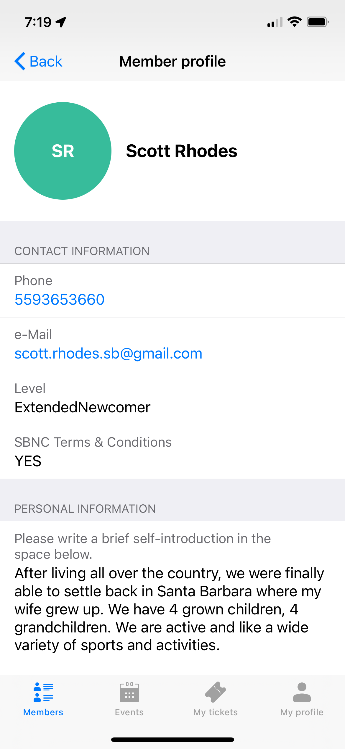
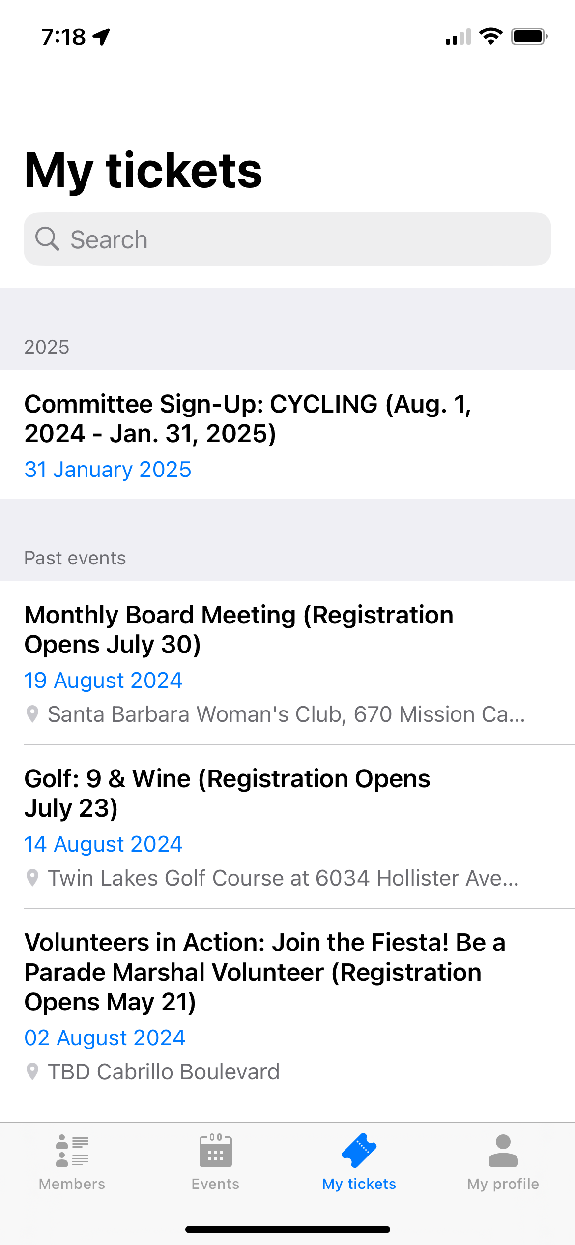
Contact Members & Tickets
Membership Lists
Track your Events

Slide 14
Last Pieces of Advice
Join
Join a committee
Sign-up any time (just reach out to chair)
Attend “Dine & Sign”
Realize
Realize everyone is new
“Newbies” have stars of their name tags usually
Go
Go to “free” and “public” events too
TGIF, Happy Hikers, Biking, etc…
Lead
Earn your 3rd year by getting involved
Remember we are all new and this is 100% volunteer run
Have Fun!
Fun

Slide 15
Questions?

